Slide 1
Investment Advisor
To presenting the Data of analyze the Investment Advisor

Slide 2
Our Team- PTDA-16 (4C)
Name: Prashant Mudare
Name: Mohd Javed
Student code: pd16_171
Student code: pd15_239
Name: Hari Krishna
Student code: pd16_258
Name: Suman Kumar
Student code: pd15_185
Notes:
Source of Image:-
https://www.freepik.com/free-photo/portrait-of-young-businessman-talking-on-mobile-phone-near-the-window_3156903.htm#term=corporate%20people&page=2&position=12
https://www.freepik.com/free-photo/smiling-business-woman-pointing-finger-on-copy-space-isolated-portrait_1119372.htm#term=corporate%20people&page=5&position=19
https://www.freepik.com/free-photo/smiling-mature-businessman-talking-on-mobile-phone_3105768.htm#term=corporate%20people&page=6&position=27
https://www.freepik.com/free-photo/smiling-brunette-manager-with-crossed-arms_899841.htm#term=corporate%20people&page=8&position=36

Slide 3
Introduction of Project
Problem Statement
Many People Faces Problem of Financial Management , They Earning So much But Due to Poor Financial Mangement Not able to Grow and Sustain.
So Here is Solution for it, We came with Project advising customers to invest their money into Best Possible way into Share Market and Secure their Future by Strong Financial Management
Solution
Our project is to find Best company to invest based on Customers Available Income for investment. We used Python Libraries Pandas and Gspread to analyse Data. and made use of excel to make charts
Strategy

Slide 4
Project Courseline
Populating Net Available Income & Net Available Expenses of Customer from Data
Populating Available Income For Investment as Follows
Available Income for Investment = Net Income - Net Expense
Distributing Available Income For investment Equally into Best Possible Companies for Investment

Slide 5
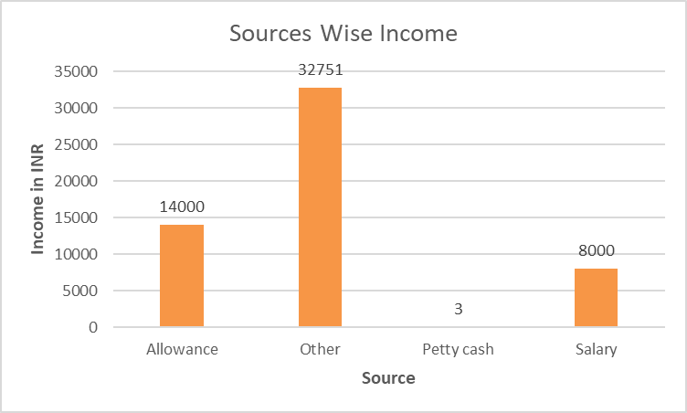
Income
Total Net Income = 54754 INR

Slide 6
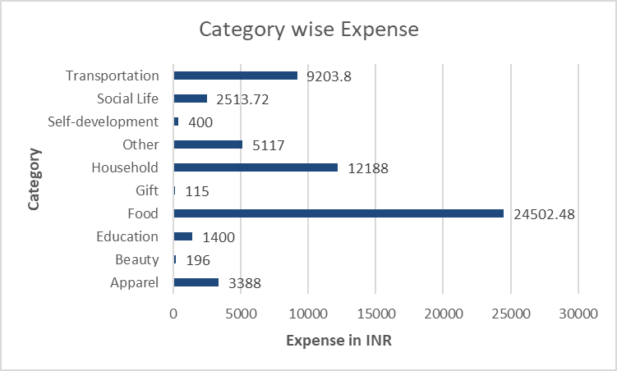
Expenses
Total Net Expenses = 59024 INR

Slide 7
Net Available Amount For Investment
Net Available Amount For Investment = Net Income - Net Expence
= 54754 INR - 59024 INR
= - 4270 INR
Here We Got Negative Value For this Particular Customer , So He/She Cannot Invest In Companies

Slide 8
As per dataset of 500 different companies we have extracted information.
Based on Indicators we created 3 investment profile for investors based on Risk Factor .
Three Investment Profile of Companies -
High Risk Investment
Moderate Risk Investment
Low Risk Investment
For Each Investment profile we take Top 5 companies for investment

Slide 9
Best Possible filters for Companies
Filters we applied for finding best trustful companies for making investment.
Small Cap Mid Cap large Cap
Market cap <= 500 Cr 5,000 to 15,000 Cr > 15,000 Cr
10 years CAGR return >= 10% >= 15% >=20%
P/E ratio 10 10 15
P/B ratio 1.5 2 2.5

Slide 10
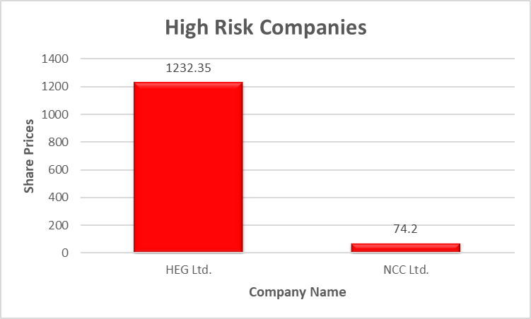
High Risk Companies
These are 2 mid cap companies which are available for investment in small cap .These are unstable companies in their Market Capital and liquidity is very low and so that it’s highly risky investment.

Slide 11
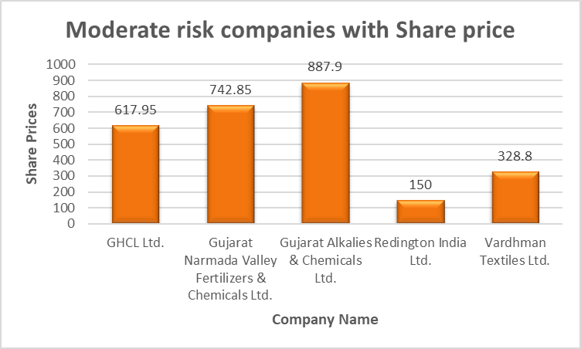
Moderate Risk Companies
The above 5 mid cap companies which are available for investment .From this we can say that these companies are quiet stable as compared to small cap in their Market Capital in risk also.

Slide 12
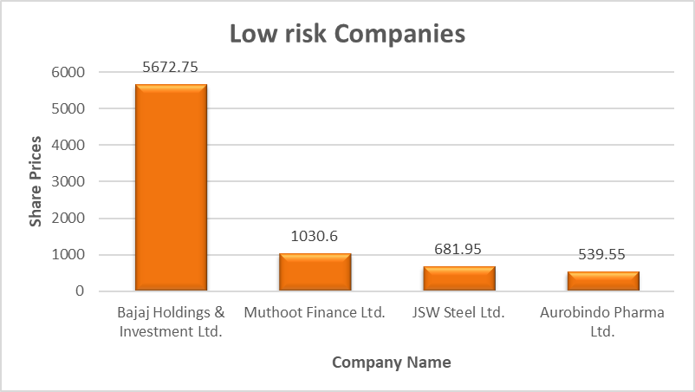
Low Risk Taking Companies
The above 4 Large cap companies which are available for investment .These companies are very stable as compared to mid cap companies in their Market Capital that’s why making investment in these companies called safest investment for investor.

Slide 13
Insights from Above Charts
From Analysis from above chart analysis -
Moderate Risk Taking Investment profile of companies is a good suggestion
for customers to invest.
- It gave Good CAGR Return in last 10 year .
- Price is quite higher as compared to book value but it’s negligible.
- Market Cap of companies quiet higher so it is a safe investment.

Slide 14
Top 5 Positive 3 Year Return of Industries
Industry | 3-Year Return
Soyabean Prod. | 564.067659
Telecom Services | 281.014142
Power Projects | 277.224583
Software | 202.458577
Natural Gas Utilities | 196.13502
From Above chart we can Say that - Soyabean Product Industry Gave Highest Return in last 3 year return so we can advise customer to invest in companies of this sector

Slide 15
Enterprise Value Sector wise
Enterprise Value of Both Sector - Insurance & Energy is quite Higher , showing that these companies has higher capital, indicating that these are sectors peoples choice to invest

Slide 16
Insights From Above Analysis
We Can Advise Customer to invest if their income available for investment is positive then into Best Possible Companies by following criteria
- Advise him to invest in Moderate Risk Companies Investment Profile.
- Investing in Soyabean Product Industry based companies
- Investing in Insurance & Energy Sector
- Not to Invest in Banking ,Housing finance , Construction based Industries.

Slide 17
Discussing the challenges and learning
1. Some challenges we faced at the connecting the gspread sheet & updating data from jupytor notebook to google sheet at that time but we all worked together , explore various resources to find solution and solved the problem.
2. We learned team management from this project.
3. We analyze the data using Python Libraries and then export the data from Google Sheets to Jupyter.
4. Firstly, we analyze the data from the spreadsheet and then make the best insights and work on those insights.
5. After that, we wrote the queries and found the data on jupyter notebook and then extract out the best insights from those data.
Notes:
https://pixabay.com/photos/room-flower-white-cabinet-plant-4161931/

Slide 18
Thank You
Have a Great Day!

